Slide 1
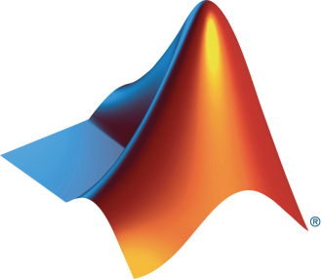
Intro to Deep Learning
Michelle Bourdon
University of Western Ontario
March 6, 2024

Slide 2
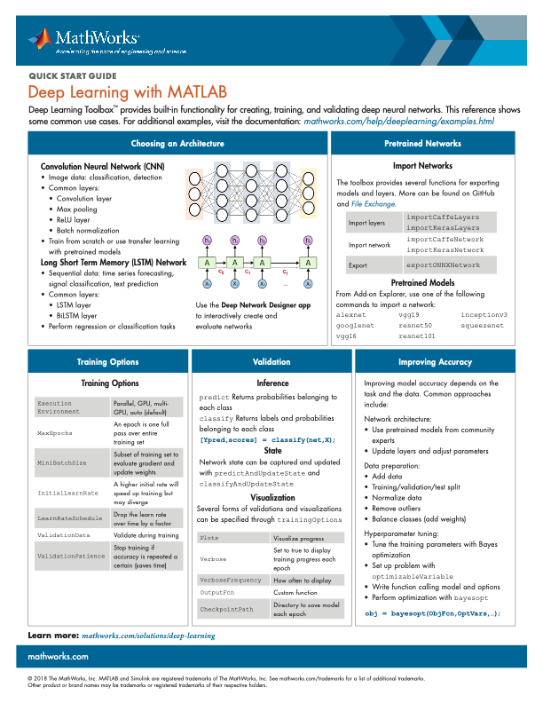
Agenda
Presentation
Intro to Deep Learning
Deep Learning Onramp
Complete 60% for a prize
Additional resources
Machine Learning Tutorial

Slide 3
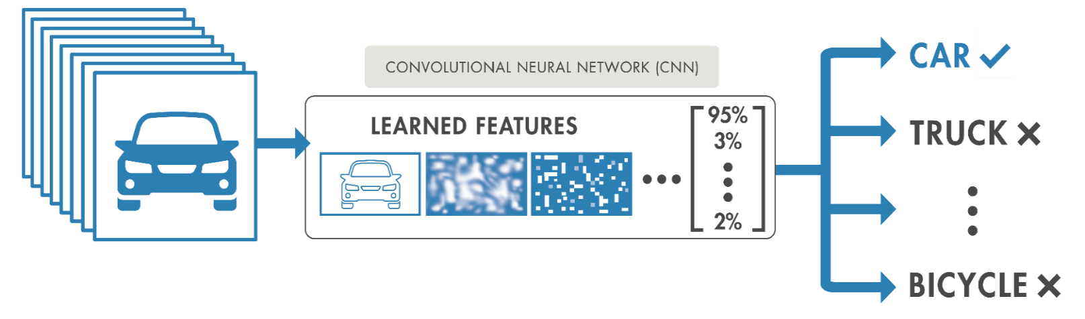
What is Deep Learning?
Subset of machine learning (ML) with automatic feature extraction
Learns features and tasks directly from data
Implemented using a neural network architecture
Deep refers to the numerous number of layers in the network
Accuracy can surpass traditional ML Algorithms
Machine Learning
Deep Learning
Deep Learning

Slide 4
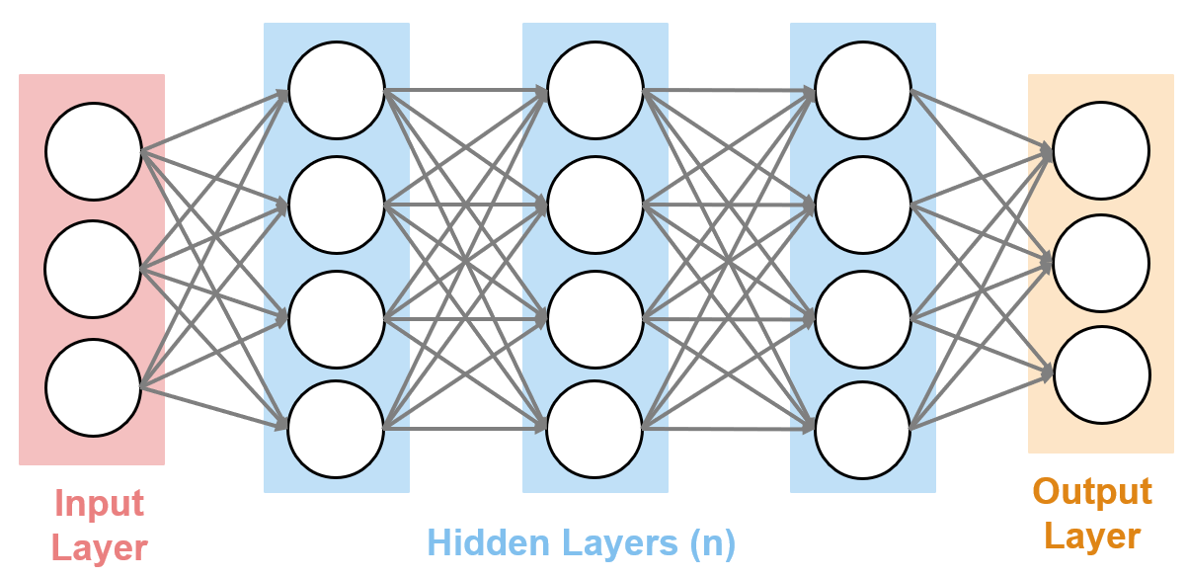
Deep Learning Models are Neural networks
Neural networks are a set of neurons that perform computations on input data to predict what the input object is
112
100
103
54
54
63
57
50
83
83
72
80
88
28
28
12
10
9
Neuron
Input data
Computations
Classification
Notes:
The underlying mechanism behind deep learning networks is a neural network architecture. Deep neural networks are broken up into many layers. For now, we will break this down into three components:
Input layer
Hidden Layers
Output Layer
Training data is passed through the network via the input layer. The hidden layers process the data and this information gets propagated forward through the network until the output layer, which usually performs classification, detection, or regression.
The weights and biases contained in the hidden layers are automatically updated through a gradient descent algorithm until the network stops training.
This is how neural networks learn from the data you provide.
Presenter Note – It can help to give a concrete example – for example, “If I have 1000 images of cars and 1000 images of bicycles, I pass them through the network. As more and more of this data is passed through, the network “learns” the differences between these two objects.

Slide 5
How can a neural network perform computations on an image or audio file?

Slide 6
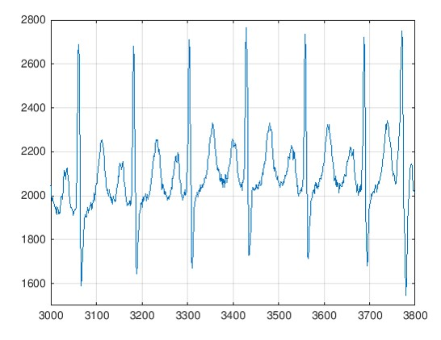
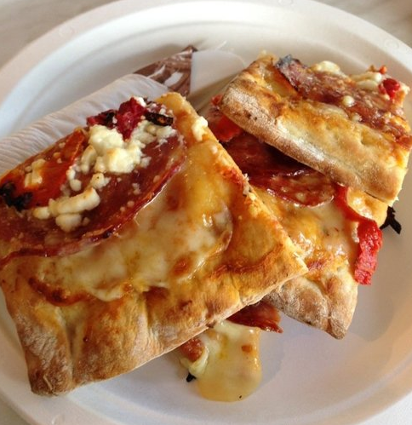
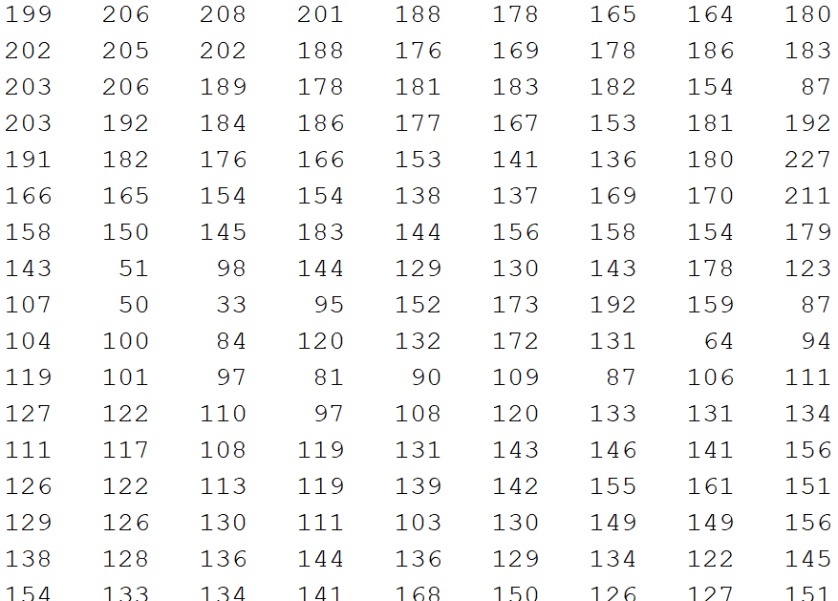
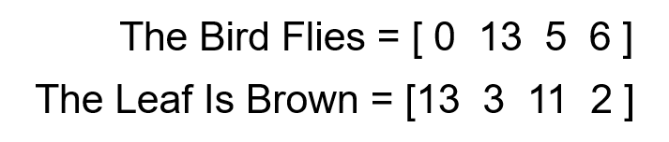
Deep Learning Networks Take in Numeric Data
Signals are numeric vectors
Images are a numeric matrix
Text is processed as numeric vectors
Notes:
The underlying data that gets passed through a deep network is always numeric. This means we can work with many types of data, like images, signals, and text.
Images are a numeric matrix
Signals are numeric vectors
Text is processed as numeric vectors
Many of these examples are image focused for instructive purposes, but our tools can work with other types of data.
To Do – open doc page to show that we have examples for all types of data.

Slide 7

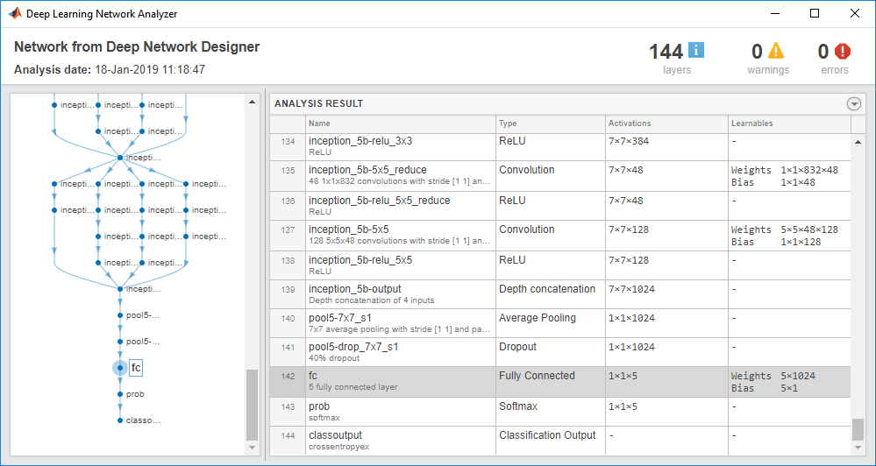
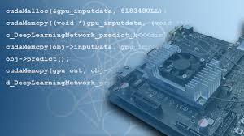




Deep Learning Workflow
Prepare Data
Build & Train Model
Deploy System
Label: Dog
Size: 524x640
Model design,
Hyperparameter tuning
Label: Lion
Size: 444x205
Model exchange across frameworks
Label: Cat
Size: 3338x2592
Hardware-accelerated training
The data must be labeled and preprocessed to give accurate results
Build a neural network that learns from your dataset
Integrate your trained model onto embedded hardware or cloud
Notes:
This is the general workflow that we follow to solve problems with deep learning.
Prepare data – Organizing and preprocessing your data is required to obtain good results (bad data = bad results)
Training your model – This is the training itself. We will focus on this for most of the workshop.
Deployment – If you are targeting embedded hardware or the cloud, you have to consider how you will accomplish this.

Slide 8
Pretrained Neural Networks
Pretrained neural networks are networks that have been designed and trained
These networks can be used to classify data just by loading it
GoogLeNet for example can be used to classify 1000 object categories, such as keyboard, mouse, pencil, and many animals
Using these networks can save time and leverage the accuracy achieved in these models
Notes:
Pretrained models can be used for classification. These models have already been trained, so you can use them to classify new images.
MATLAB supports many models that can be installed in a few clicks. Here are some of the models and where you might use them (describe diagram).

Slide 9
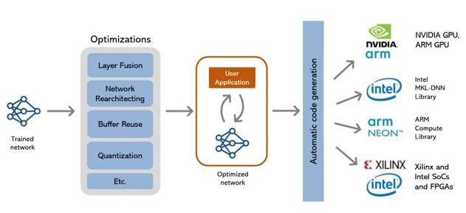
Deploying neural networks
Use MATLAB to deploy the trained model to:
GPUs and CPUs
Embedded devices (e.g. NVIDIA or Raspberry Pi)
Standalone applications
Web Apps

Slide 10
Resources to get started on your own
Free Deep learning onramp course
What we are doing today!
Free Machine learning onramp course
Next time!

Slide 11
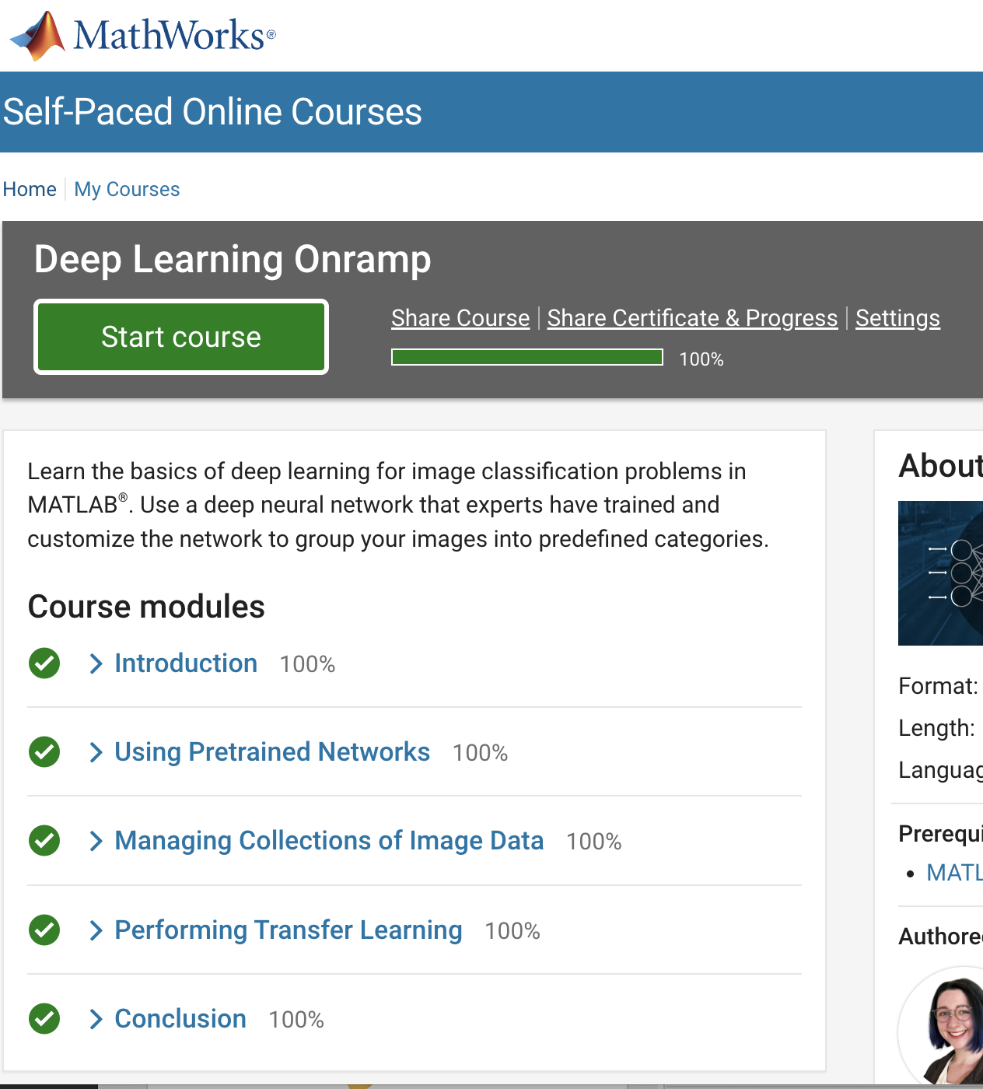
TO DO
Create your UWO - MathWorks Account
https://www.mathworks.com/academia/tah-portal/western-university-964054.html
Go to Deep Learning Onramp
(Within the AI, Machine Learning, and Deep Learning Tab)
https://matlabacademy.mathworks.com/
Launch Deep Learning Onramp
Notes:
The first step is to setup a MathWorks account tied to your UWO login
After this, you can run the MATLAB Onramp from the second URL online or
from your installed version of MATLAB

Slide 12
MATLAB Prizes
Complete at least 60% of the Deep Learning Onramp to be eligible for any prize
Bring your laptop when you come to collect the prize
Follow us on Instagram!
@UWOMATLAB
Notes:
Once you have done most of the Onramp in the amount of time we have for this room, show me and you will receive a prize
Also, you MUST follow us on Instagram to receive a prize!

